Slide 1
Software Engineering Individual Project
Tiles
Week 12 Presentation
- Saurabh Pathak

Slide 2
Quick Recap of the game
The game will present a 2X2 matrix of tiles.
Each tile will have a unique number or a pattern hidden behind it.
Each unique number/pattern exists twice in the matrix.
Once the player taps a tile, it flips and shows the pattern behind it.
The player has to match (by tapping consecutively) two tiles with same number/pattern hidden behind them.
If you match two tiles with different pattern, both the tiles will rotate and hide the pattern behind them.

Slide 3
core elements
2D matrix of tiles
Timer as per level
Patterns which will get complicated as per level (dropped)
Retaining last state of the game

Slide 4
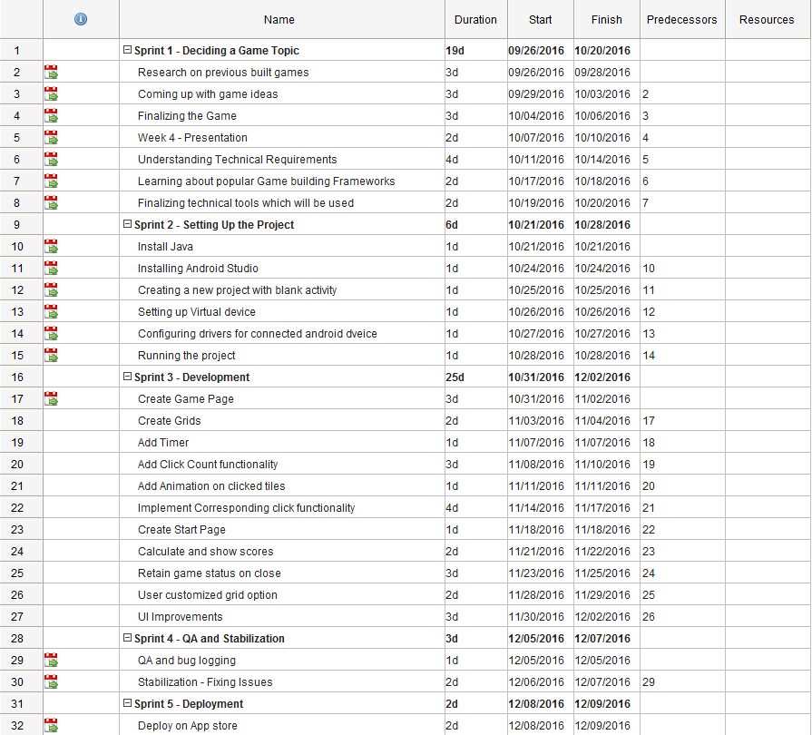
Planning and management
Click here for complete Gantt chart

Slide 5
Progress So Far
The Game works!!!
A static 2D matrix of 20 tiles has been implemented.
Counter for number of clicks works as per requirements.
The timer records the time starting with the first click.

Slide 6
Project Status as per gantt chart
For now the project is a week delayed.
Pending Enhancements are - User specific grid size. - User Customized Grid option

Slide 7
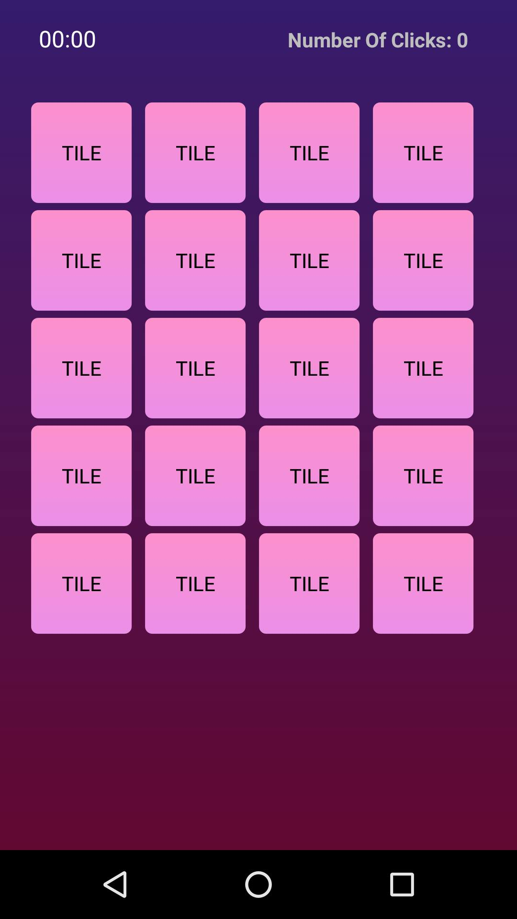
User Interface of the Game
Initial screen after starting game

Slide 8
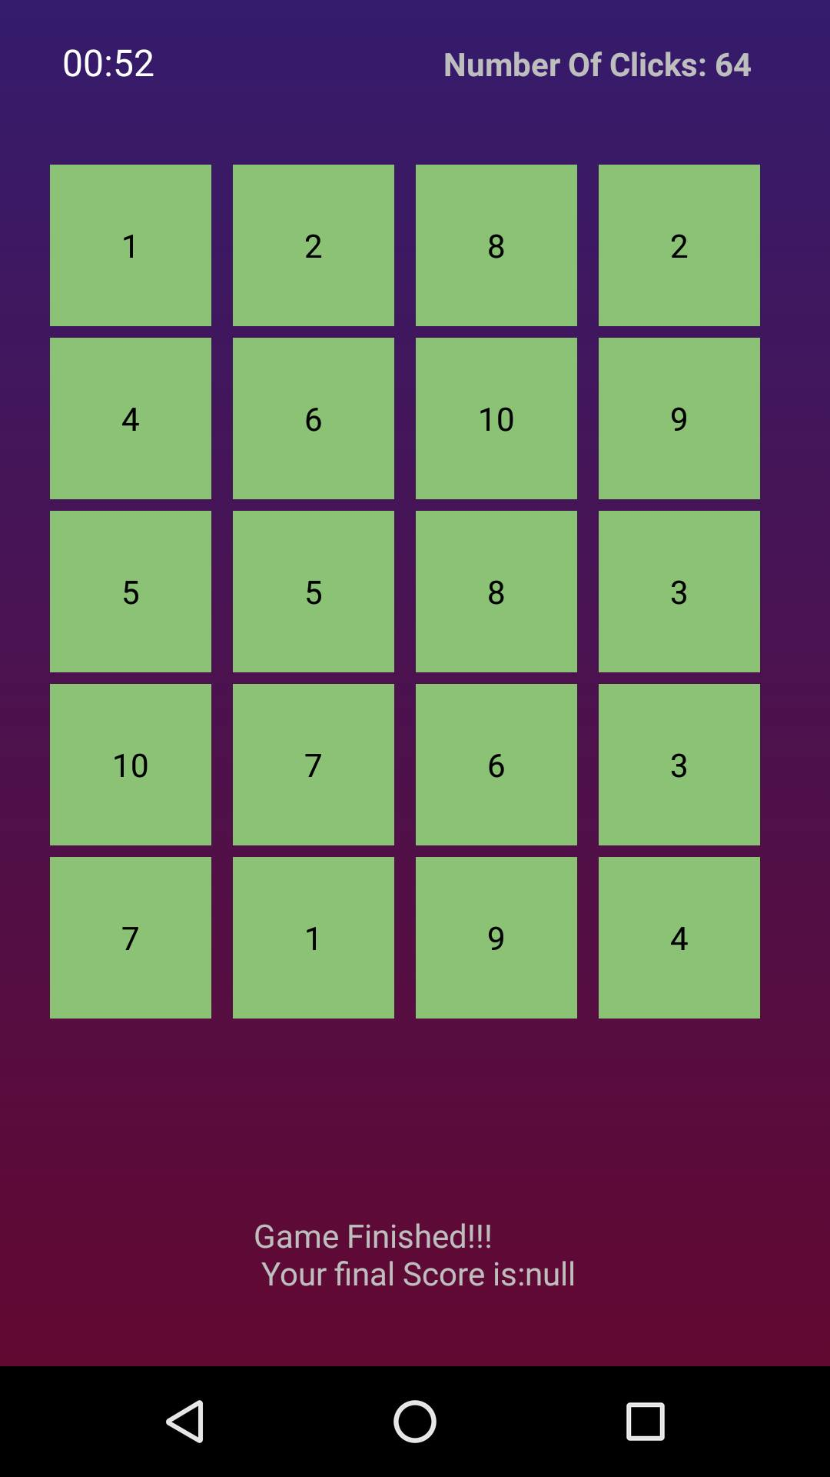
User Interface of the Game
Game completion screen

Slide 9
Pending Issues
Storing clicks and chronometer time on game discard.
Adding UI for grid size selector.
Resume Game button should activate on press of back button.
Add some instructions for playing the game.

Slide 10
junit test cases
isArrayMatching – for generating tile grid values.
isListUnlocked – for checking whether complete list is unlocked or not.
isListLocked – for checking whether complete list is unlocked or not.
isJsonValid – whether json created for storing in sharedpreferences is valid.

Slide 11
Thank you!

